Slide 1
CS630 AI Agent Engineering Module 02 Experiencing AI Agents with Tools
Primary Agent Types
LLM Agent vs Workflow Agent vs Custom Agent
Guiding the Agent
Class Diagram for Agents
Deployment Diagrams for Agents
Notes:
In this module 01, we will study the concepts of a basic AI agent.

Slide 2
Agent
Self-contained execution unit
Operate autonomously
Perform tasks
Interact with users
Utilize external tools
Coordinate with other agents
(Google, 2025)

Slide 3
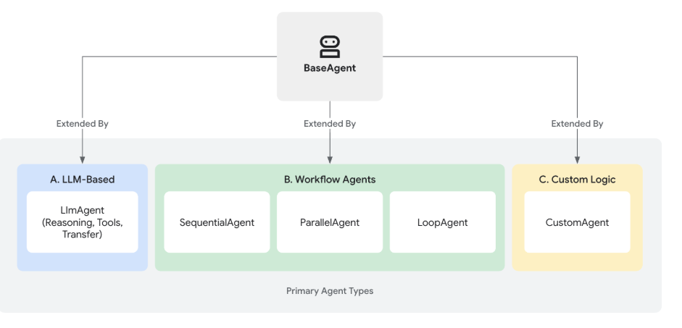
Primary Agent Types
(Google, 2025)
Notes:
The foundation for all agents in ADK is the BaseAgent class. It serves as the fundamental blueprint. To create functional agents, you typically extend BaseAgent in one of three main ways, catering to different needs – from intelligent reasoning to structured process control.
Agents Working Together: Multi-Agent Systems
While each agent type serves a distinct purpose, the true power often comes from combining them. Complex applications frequently employ multi-agent architectures where:
LLM Agents handle intelligent, language-based task execution.
Workflow Agents manage the overall process flow using standard patterns.
Custom Agents provide specialized capabilities or rules needed for unique integrations.
ADK provides distinct agent categories to build sophisticated applications:
LLM Agents
These agents utilize Large Language Models (LLMs) as their core engine to understand natural language, reason, plan, generate responses, and dynamically decide how to proceed or which tools to use, making them ideal for flexible, language-centric tasks.
We need to learn how to configure agents powered by large language models, including setting instructions, providing tools, and enabling advanced features like planning and code execution
Workflow Agents
These specialized agents control the execution flow of other agents in predefined, deterministic patterns (sequence, parallel, or loop) without using an LLM for the flow control itself, perfect for structured processes needing predictable execution.
We need to learn how to orchestrate tasks using SequentialAgent, ParallelAgent, and LoopAgent for structured and predictable processes.
Custom Agents
Created by extending BaseAgent directly, these agents allow you to implement unique operational logic, specific control flows, or specialized integrations not covered by the standard types, catering to highly tailored application requirements
We need to learn how to orchestrate tasks using SequentialAgent, ParallelAgent, and LoopAgent for structured and predictable processes.
Multi-Agents: Understand how to combine different agent types to create sophisticated, collaborative systems capable of tackling complex problems.
Models: Learn about the different LLM integrations available and how to select the right model for your agents.

Slide 4
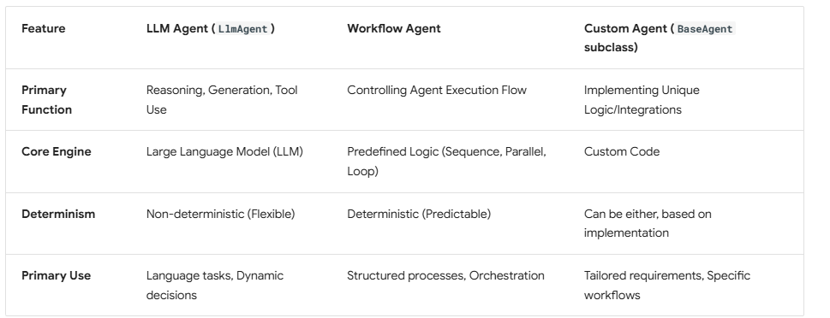
Agents: LLM vs Workflow vs Custom
(Google, 2025)
Notes:
LLM Agent (LlmAgent)
Use Case: Customer Support Chatbot with Tool Use An LLM agent is used to handle customer queries on a website. It can generate natural responses, look up FAQs, and call external tools like a weather API, product search, or order tracking system. Because it's powered by an LLM, it can dynamically respond to various topics with flexibility, even those not hardcoded in advance.
Workflow Agent
Use Case: Automated Onboarding Sequence A Workflow Agent manages a structured onboarding process for new employees. It executes tasks like sending welcome emails, setting up accounts, and scheduling orientation meetings in a deterministic sequence. It ensures that tasks happen in the correct order—sometimes in parallel or looped—without needing flexible language understanding.
Custom Agent (BaseAgent subclass)
Use Case: Slack Bot for Internal DevOps Tools A company creates a custom agent to integrate with its internal CI/CD systems. It accepts natural language commands via Slack, then runs custom Python code to deploy apps, fetch logs, or restart servers. This agent uses hardcoded logic and integrates with internal APIs, making it highly tailored to unique infrastructure.

Slide 5
LLM Agent
The LlmAgent acts as the "thinking" part of your application.
LlmAgent behavior is non-deterministic.
interpret instructions and context, deciding how to proceed, which tools to use or transfer to another agent.
Effective LlmAgent involves defining its identity, clearly guiding its behavior through instructions, and equipping it with the necessary tools and capabilities.
(Google, 2025)
Notes:
The LlmAgent (often aliased simply as Agent) is a corecomponent in ADK, acting as the "thinking" part of yourapplication.
LlmAgent behavior is non-deterministic.- Unlike deterministic Workflow Agents that follow predefined execution paths
Uses the LLM to interpret instructions and context,deciding dynamically how to proceed, which tools to use(if any), or whether to transfer control to another agent.
Building an effective LlmAgent involves defining itsidentity, clearly guiding its behavior through instructions,and equipping it with the necessary tools and capabilities.

Slide 6
Defining the Agent's Identity and Purpose
name (Required)
description (Optional, Recommended for Multi-Agent)
model (Required)
# Example: Defining the basic identity
capital_agent = LlmAgent(
model="gemini-2.0-flash",
name="capital_agent",
description="Answers user questions about the capital city of a given country."
# instruction and tools will be added next
)
(Google, 2025)
Notes:
First, you need to establish what the agent is and what it's for.
name (Required): Every agent needs a unique string identifier. This name is crucial for internal operations, especially in multi-agent systems where agents need to refer to or delegate tasks to each other. Choose a descriptive name that reflects the agent's function (e.g., customer_support_router, billing_inquiry_agent). Avoid reserved names like user.
description (Optional, Recommended for Multi-Agent): Provide a concise summary of the agent's capabilities. This description is primarily used by other LLM agents to determine if they should route a task to this agent. Make it specific enough to differentiate it from peers (e.g., "Handles inquiries about current billing statements," not just "Billing agent").
model (Required): Specify the underlying LLM that will power this agent's reasoning. This is a string identifier like "gemini-2.0-flash". The choice of model impacts the agent's capabilities, cost, and performance. See the Models page for available options and considerations.

Slide 7
Guiding the Agent: Instructions (instruction)
The instruction parameter is arguably the most critical for shaping an LlmAgent's behavior.
Its core task or goal.
Its personality or persona
Constraints on its behavior
How and when to use its tools.
The desired format for its output
(Google, 2025)
Notes:
Guiding the Agent: Instructions (instruction)¶
The instruction parameter is arguably the most critical for shaping an LlmAgent's behavior. It's a string (or a function returning a string) that tells the agent:
Its core task or goal.
Its personality or persona (e.g., "You are a helpful assistant," "You are a witty pirate").
Constraints on its behavior (e.g., "Only answer questions about X," "Never reveal Y").
How and when to use its tools. You should explain the purpose of each tool and the circumstances under which it should be called, supplementing any descriptions within the tool itself.
The desired format for its output (e.g., "Respond in JSON," "Provide a bulleted list").

Slide 8
Tips for Effective Instructions:
Be Clear and Specific
Use Markdown
Provide Examples (Few-Shot)
Guide Tool Use
instruction="""You are an agent that provides the capital city of a country. When a user asks for the capital of a country:
1. Identify the country name from the user's query.
2. Use the `get_capital_city` tool to find the capital.
3. Respond clearly to the user, stating the capital city.
Example Query: "What's the capital of {country}?" Example Response: "The capital of France is Paris." """,
(Google, 2025)
Notes:
Tips for Effective Instructions:
Be Clear and Specific: Avoid ambiguity. Clearly state the desired actions and outcomes.
Use Markdown: Improve readability for complex instructions using headings, lists, etc.
Provide Examples (Few-Shot): For complex tasks or specific output formats, include examples directly in the instruction.
Guide Tool Use: Don't just list tools; explain when and why the agent should use them.

Slide 9
Class Diagram
A class diagram is a type of UML (Unified Modeling Language) diagram used in object-oriented design to visually represent the structure of a system by showing its classes, attributes, methods, and relationships.
It helps software engineers and architects understand the blueprint of the system—how different objects (classes) interact and relate to each other.

Slide 10
Class Diagram Key Components
Component | Description
Class | Represented as a rectangle with three sections: class name, attributes (variables), and methods (functions).
Attributes | Variables or data fields of the class (e.g., name, age).
Methods | Operations or functions the class can perform (e.g., getName(), calculateSalary()).
Relationships | Includes association, inheritance, aggregation, and composition between classes.

Slide 11
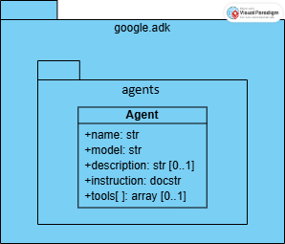
LLM Agent Class Diagram

Slide 12
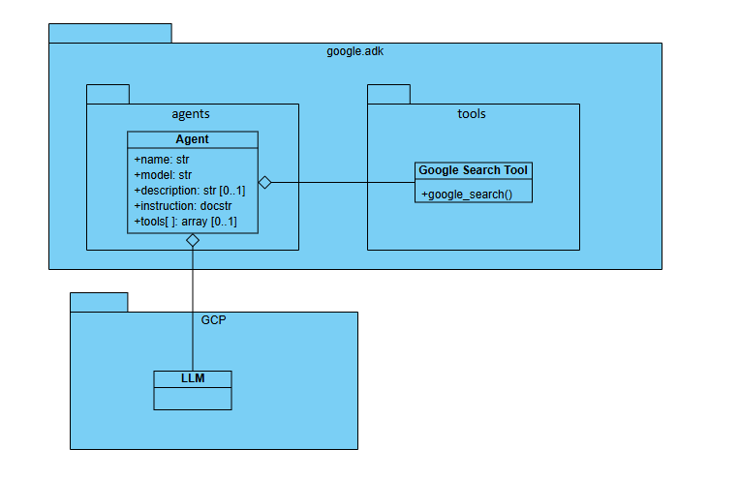
Tool Agent with Google Search Class Diagram

Slide 13
Deployment Diagram
A deployment diagram is a type of UML (Unified Modeling Language) diagram used to model the physical architecture of a system—how software components are deployed across hardware nodes.
To show where and how system components (like databases, applications, or services) run in the real-world infrastructure—useful in DevOps, cloud architecture, and system design.

Slide 14
Deployment Diagram Key Components
Element | Description
Node | A physical or virtual device (e.g., server, mobile phone, router). Shown as a 3D box.
Artifact | A software component (e.g., .exe, .jar, scripts, databases). Deployed onto nodes.
Communication Path | A connection between nodes (e.g., TCP/IP link, cloud message bus).

Slide 15
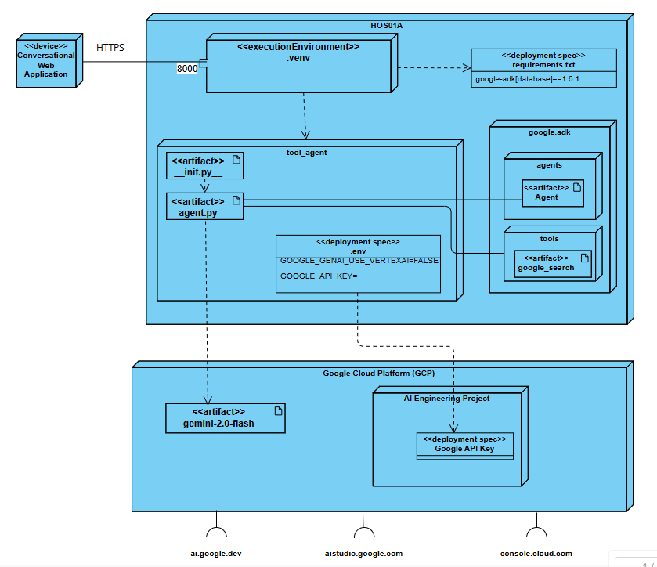
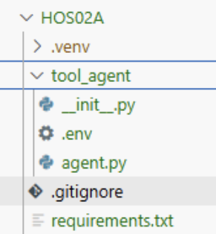
Tool Agent with Google Search Deployment Diagram

Slide 16
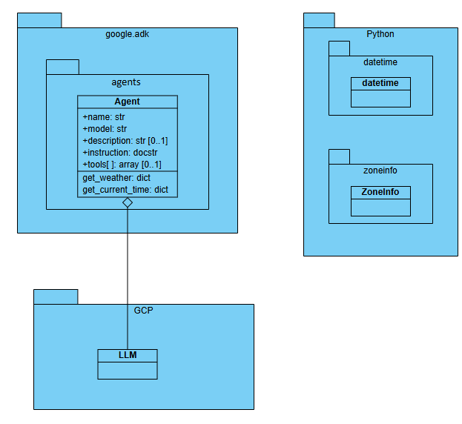
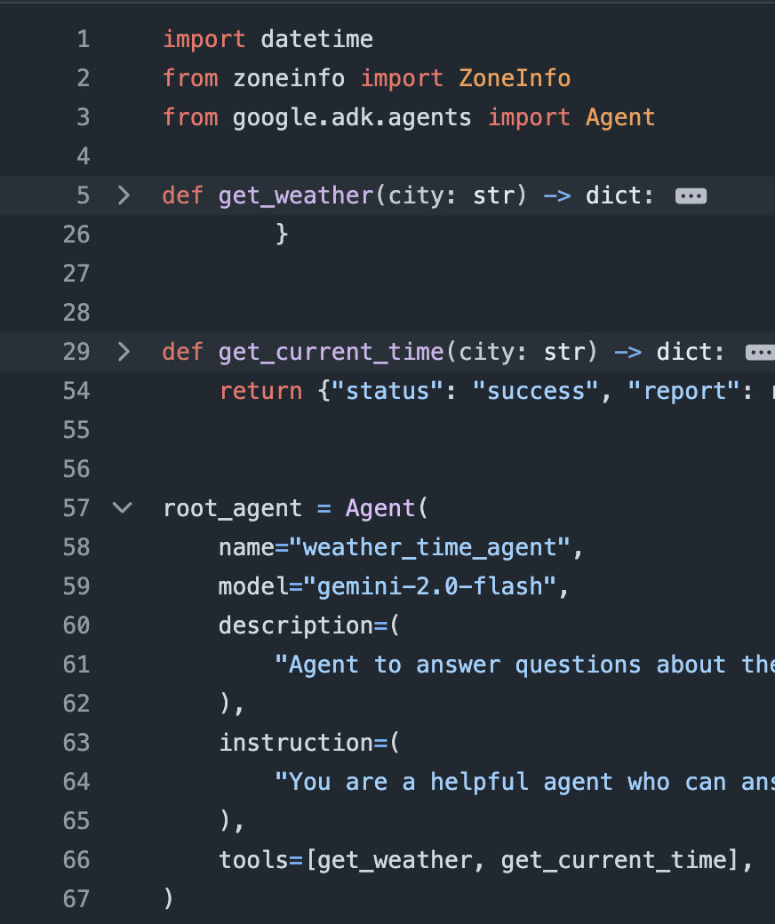
Multi tool agent with custom tool: get_weather and get_current_time Class Diagram

Slide 17
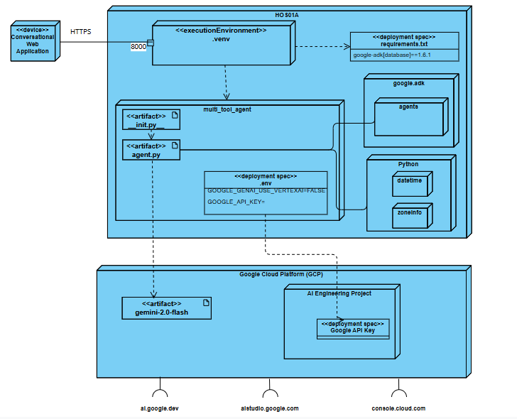
Multi tool agent with custom tool: get_weather and get_current_time Deployment Diagram

Slide 18
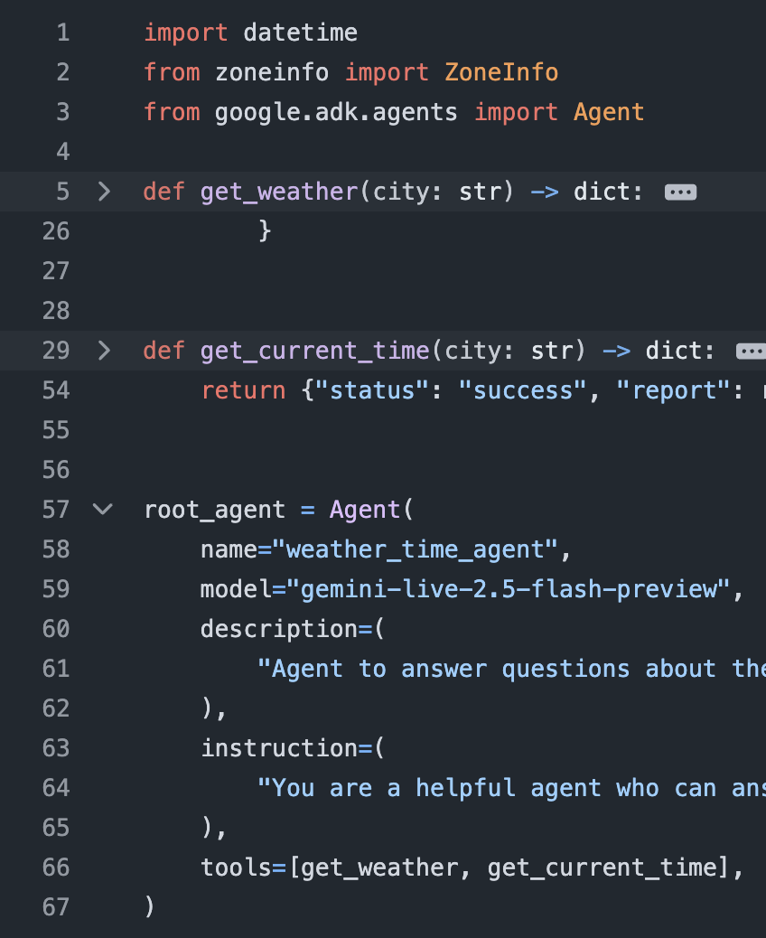
Multi tool agent with voice Class Diagram

Slide 19
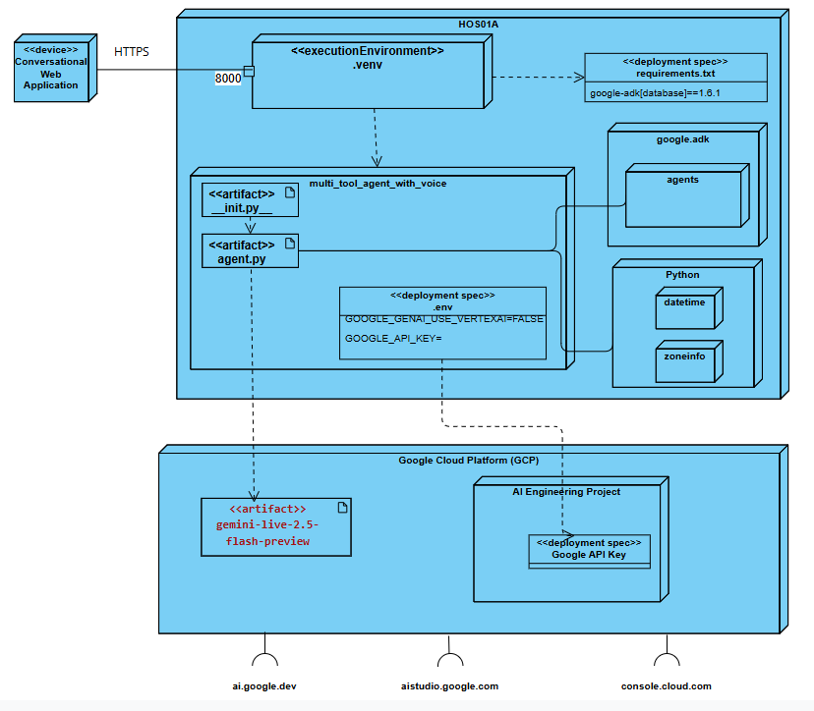
Multi tool agent with voice Deployment Diagram

Slide 20
Summary & Final Thoughts
Agent Types in Google ADK
LLM Agent: Dynamic, LLM-driven reasoning and tool use
Workflow Agent: Orchestrates steps using structured logic
Custom Agent: Tailored logic for specialized needs
Agent Identity & Purpose
Defined through name, description, and instruction
Crucial for role clarity and safe, goal-aligned behavior
Architectural Overview
Class Diagram → Shows inheritance and structure of agent types
Deployment Diagram → Illustrates agent interaction with tools, models, and external APIs
Notes:
Designing the right agent starts with understanding its purpose, crafting its identity, and choosing the appropriate type and architecture.

Slide 21
References
Google Agent Development Kit (ADK)
google-adk·PyPI
Gemini models | Gemini API | Google AI for Developers
Brandon Hancock's ADK Crash Course
Module 2: Tool Agent
Brandon Hancock's ADK Masterclass: Build AI Agents & Automate Workflows (Beginner to Pro) (3:12:47)
Module 2: Tool Agent (0:23:00 – 0:35:20)
Google. (2025). Agent Development Kit. Github.io. https://google.github.io/adk-docs/agents/llm-agents/#guiding-the-agent-instructions-instruction
‌

Slide 22

Q&A
Notes:
In this module 01A, we discussed the following topics:
If you have any questions, feel free to contact me.
Thank you

